Slide 1
NLP – 2022-2023 CAPSTONE PROJECT FINAL REVIEW SENTIMENT ANALYSIS OF Twitter data B. Vishnu Priya - 19K41A05F1 D. Sujitha Rao - 19K41A05F3 R. Rakesh - 20K45A0222 Under the guidance of D. Ramesh Assistant Professor of CSE

Slide 2
Introduction
Advantages
Objectives
Literature review
Beneficiaries
Natural Language Processing
Dataset Insights
Data Preprocessing
Results
Conclusion
References
AGENDA

Slide 3
INTRODUCTION
Sentiment Analysis (or Opinion Mining or emotion AI) is a technique of Natural Language Processing (NLP) that is used to find the sentiment of the data that whether the data is positive or negative or neutral.
In simple words, this program will take an input which could be a sentence written in any language, and then it will say whether the sentence is having a positive sentiment or negative or neutral based on its sentiment scores.
It is used by the companies to find out the sentiment of the feedback given by the customers on any product to have a better understanding of the need of the customer and to provide them a better product.

Slide 4
Advantage of Sentiment Analysis:
To track overall customer satisfaction: It is used to track the satisfaction of the customers by analyzing their feedback’s sentiment which helps them to understand how satisfied the customers are after purchasing their product.
To find out happiest customers: It can be used to find out the happiest customers after analyzing the feedbacks and it will help them to target their happiest customers to give some discounts, or any benefits or to sell more products to them.
To train the chatbots: It is used to train the chatbots which you can find on some websites and these chatbots reply to the users on the basis of their sentiment and this can be very helpful for the website owners.
Identifying key emotional triggers: It can be used to identify the emotional triggers so that the chatbots will reply with those words which can directly connect with the users. For example, it can reply “Please wait” so that the user will gather patience while chatting with the bots.

Slide 5
OBJECTIVES
The main objective of this study is to classify user reviews into positive, negative or neutral sentiment . This have some applications like :
Business: A lot of companies utilize Twitter Sentiment Analysis for developing their business tactics to consider customers’ feelings for brand or products, how people react to their product launches or campaigns as well as why customers are not purchasing certain products.
Politics: Twitter Sentiment Analysis is used for keeping track of the political views, detect consistency or inconsistency between actions and statements at government levels. It is also utilized to analyze election outcomes.
Public Actions: Twitter Sentiment Analysis is used to analyze and monitor social phenomena, to predict possibly dangerous situations as well as determining the normal mood of a blogosphere.

Slide 6
LITERATURE REVIEW
S. NO | TITLE | MODELS USED | BEST MODEL AND ACCURACY
1 | Sentiment Analysis of Customer Reviews Using Ensemble Method | Bagging, Naive Bayes, Support Vector Machines (SVMs), Random forest and Boosting. | Random forest with accuracy 89.87%
2 | Sentiment Analysis of Customer Product Reviews Using Machine Learning | Naive Bayesian, Support Vector Machine and Decision Tree. | Support Vector Machine with accuracy 81.75%
3 | Customer Satisfaction Measurement using Sentiment Analysis | Naive Bayes, Support Vector Machine | Support Vector Machine with accuracy 87%

Slide 7
S.NO | TITLE | MODELS USED | BEST MODEL AND ACCURACY
4 | Sentiment Analysis of Restaurant Customer Reviews on TripAdvisor using Naive Bayes | Naive Bayes, Text-Blob | Naïve Bayes with accuracy 72.06%
5 | Automatic Sentiment Analysis in On-line Text | Support Vector Machines, naive Bayes Multinomial, Maximum Entropy | Support Vector Machine with 90.25%

Slide 8

BENEFICIARIES
Analyzing tweets to do sentiments remains an important marketing exercise for a company that wants to listen as well as learn from customers’ experiences. Besides social listening, Text Analytics API may also help companies to scrape Twitter for brand insights, business intelligence, opinions, online reputation management, or the voice of customers.
These insights dig deeper into the roots of these issues in order to prepare a more sustainable strategy for product and service improvement.

Slide 9
NATURAL LANGUAGE PROCESSING
Natural language processing (NLP) refers to the branch of computer science—and more specifically, the branch of artificial intelligence or AI—concerned with giving computers the ability to understand text and spoken words in much the same way human beings can.
Because, there are billions of people and they have their own style of communicating, i.e. a lot of tiny variations are added to the language and a lot of sentiments are attached to it which is easy for us to interpret but it becomes a challenge for the machines.
This is why we need a process that makes the computers understand the Natural Language as we humans do, and this is what we call Natural Language Processing(NLP). And, as we know Sentiment Analysis is a sub-field of NLP and with the help of machine learning techniques, it tries to identify and extract the insights.

Slide 10

UNIVERSAL SENTENCE ENCODER The universal sentence encoder makes looking up embeddings at the sentence level as simple as it has previously been to look up embeddings at the word level. Then, using less supervised training data, the sentence embeddings can be easily employed to compute sentence-level meaning similarity and improve performance on subsequent classification tasks. It converts textual information into numerically represented, high-dimensional vectors called embeddings. LSTM LSTM network is fed by input data from the current time instance and output of hidden layer from the previous time instance. These two data passes through various activation functions and valves in the network before reaching the output.

Slide 11

DATASET INSIGHTS
The dataset is based on Twitter tweets from Kaggle which has three columns S.No, Text and Sentiment. Dataset consists of 10729 rows and 2 columns.
Second column: Text
This column includes the tweets of the users.
Third column: Sentiment
This column describes the sentiment of the tweet like- positive, negative or neutral.

Slide 12
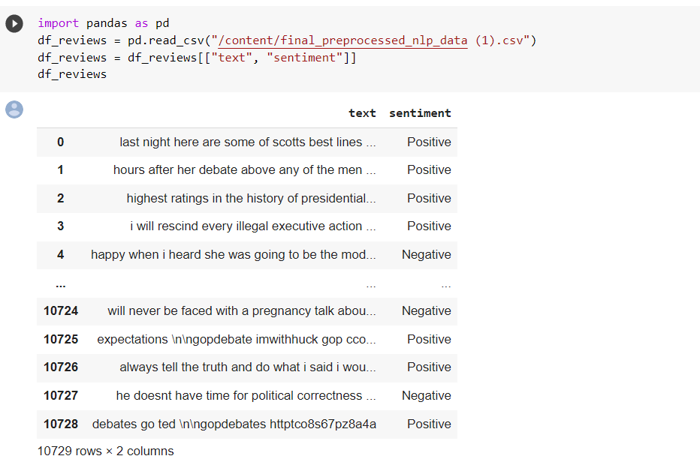

Slide 13
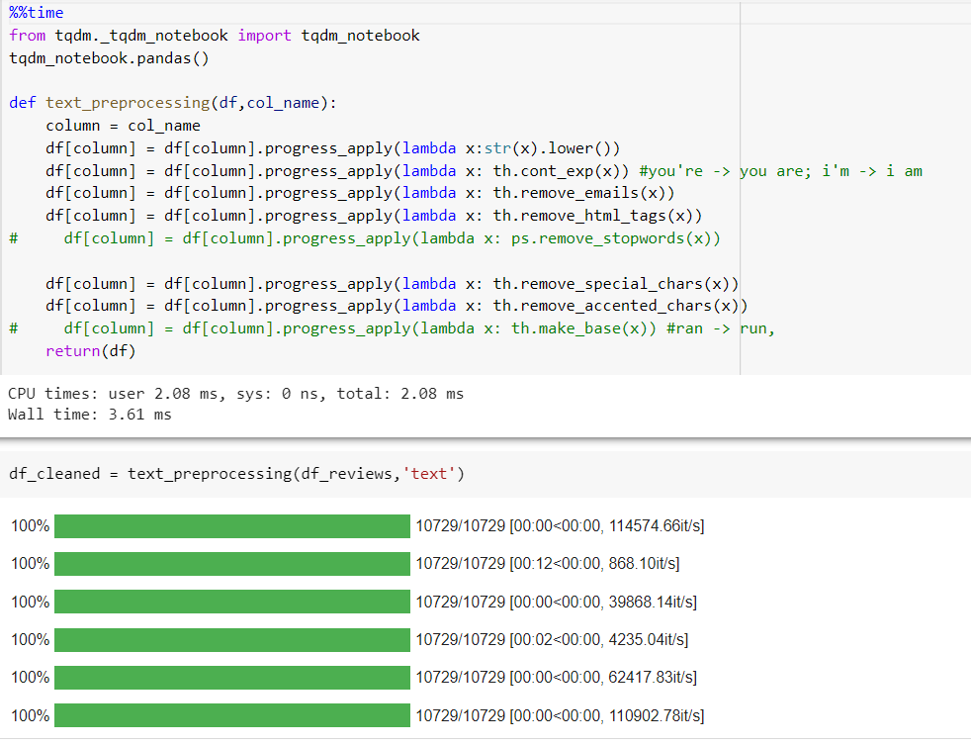
DATA PREPROCESSING

Slide 14
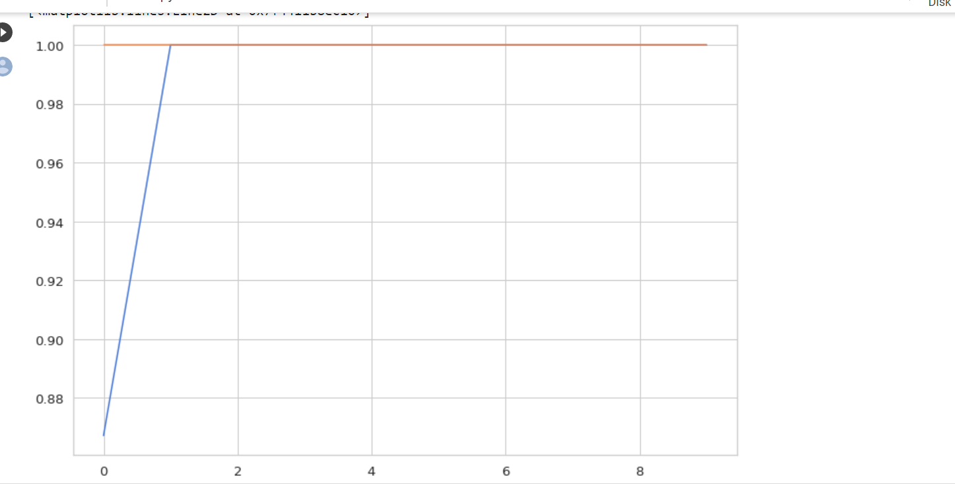
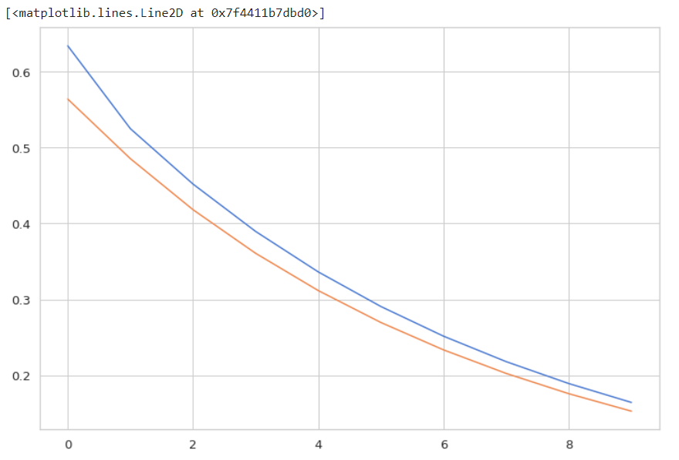
RESULTS
Model loss
Model accuracy

Slide 15
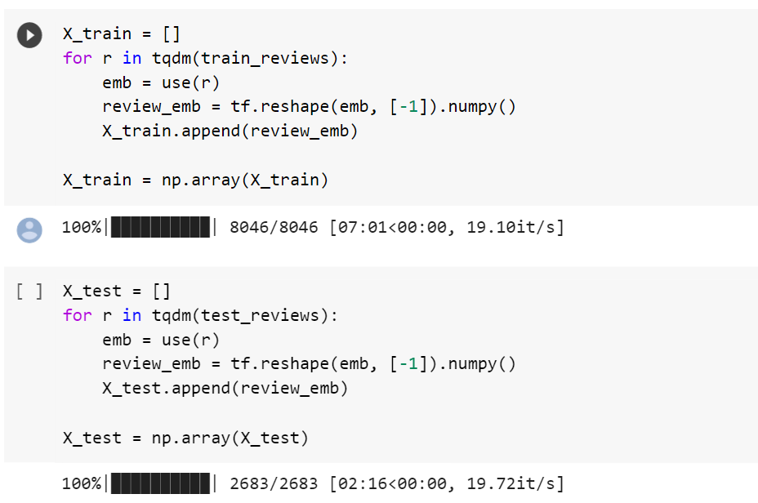
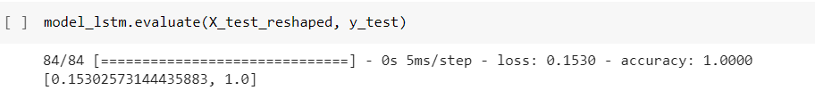
Embedding:-
Accuracy:-

Slide 16

CONCLUSION
Sentiment analysis is a field of study that analyzes people’s sentiments, attitudes, or emotions towards certain entities. It tackles a fundamental problem of sentiment analysis, sentiment polarity categorization. A sentiment polarity categorization process has been proposed along with detailed descriptions of each step. Experiments for both sentence-level categorization and review-level categorization have been performed. We have considered twitter tweets to analyzed the sentiments and proposed the model with Universal sentence encoder and LSTM. Universal sentence encoder is to embed text into high dimensional vectors of size 512 that is used for natural language tasks. LSTM is capable of learning long term dependencies and predicts future output from sequence of inputs. Finally, we have observed that our technique is accurate and efficient.

Slide 17
references
1. T. Chalothom and J. Ellman, “Simple Approaches of Sentiment Analysis via Ensemble Learning,” Springer, Berlin, Heidelberg, 2015, pp. 631–639.
2. L. Naji, "Twitter Sentiment Analysis Training Corpus (Dataset)," 22 september 2012.
3. S. Hridoy, M. Ekram, M. Islam and R. M. Rahman, "Localized twitter opinion mining using sentiment analysis," Decision Analytics, vol. 2, no. 1, 22 october 2015.
4. Q. Ye, Z. Zhang, and R. Law, “Sentiment classification of online reviews to travel destinations by supervised machine learning approaches,” Expert Systems with Applications, vol. 36, no. 3, pp. 6527–6535, 2009.
5. A. S. Abrahams, J. Jiao, G. A. Wang, and W. Fan, "Vehicle defect discovery from social media”, Decision Support Systems, vol. 54, pp. 87-97, 2012.

Slide 18
Thank you

